Slide 1

My Projects: A To-Do List and a Calculator
I've embarked on a journey to build two exciting projects - a to-do list application and a simple calculator. These projects will allow me to showcase my skills in HTML, CSS, and JavaScript, and help me grow as a web developer.

Slide 2
HTML: Building the Structure
To-Do List
Crafted the HTML structure for a user-friendly to-do list interface, interface, including input fields, task display, and buttons for adding, adding, completing, and deleting tasks.
Calculator
Designed the HTML layout for a simple calculator, with input fields,
input fields, operation buttons, and a display area to show the the results of calculations.

Slide 3
CSS: Styling the Interfaces
To-Do List
Utilized CSS to give the to-do list a clean and organized appearance, appearance, with intuitive user interactions and visually appealing appealing elements.
Calculator
Styled the calculator interface with a modern and minimalist design,
design, ensuring the buttons and display blend seamlessly for a for a polished look.

Slide 4
JavaScript: Bringing Interactivity
To-Do List
Implemented JavaScript to add dynamic functionality to the to-do list, such as adding new tasks, marking tasks as complete, and deleting tasks.
Calculator
Used JavaScript to handle user inputs, perform arithmetic operations, and display the results in the calculator interface. interface.

Slide 5
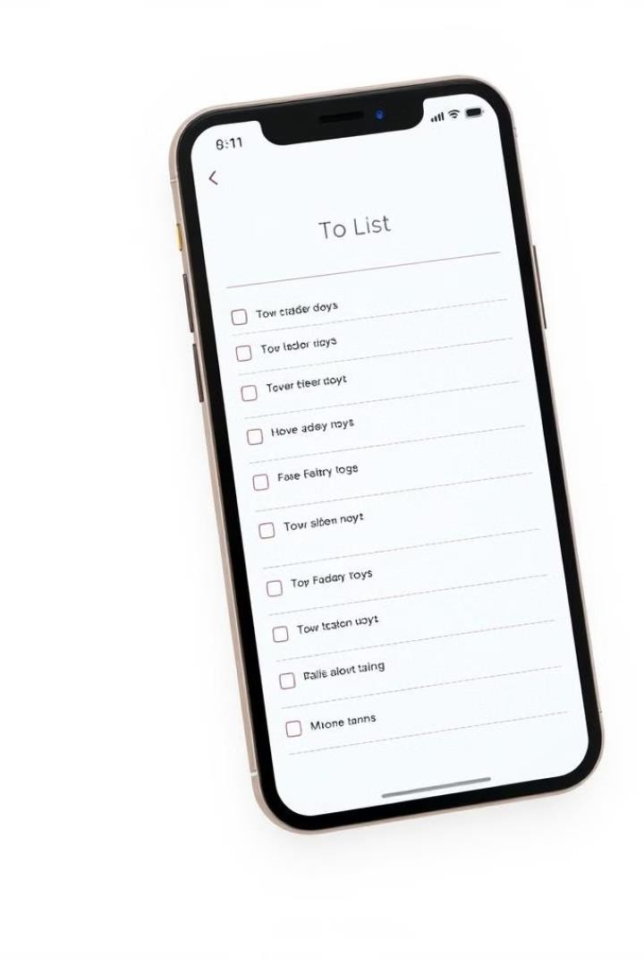
To-Do List Application: Features Features and Functionality
1
Task Input
2
Task Deletion
Users can easily add new tasks tasks to the list by typing in the the input field and pressing the the "Add" button.
Users can remove completed completed tasks from the list by list by clicking the "Remove" "Remove" button next to the the task they want to remove. remove.

Slide 6





Calculator Application: Performing Arithmetic Operations Operations
Addition
Subtraction
Multiplication
Division
The calculator can perform addition of two numbers, displaying the result instantly.
Users can subtract one number from another, with the difference shown in the display.
The calculator can multiply two two numbers, providing the product in the display.
Users can divide one number by by another, with the quotient displayed.

Slide 7

Skills Gained: Problem-Solving, Coding, and Application Development
1
Problem-Solving
2
Coding Skills
3
Application Development
Developing these projects helped me strengthen my problem-solving skills, as I had to break down complex tasks and find efficient solutions.
Implementing the functionality of the to- the to-do list and calculator applications applications allowed me to enhance my my coding abilities in HTML, CSS, and and JavaScript.
The experience of building these projects projects from start to finish gave me valuable insights into the entire application development process.

Slide 8
Thank You
I'm grateful for the opportunity to showcase my projects and the skills I've gained. These experiences have been invaluable in my journey as a web developer, and I'm excited to continue learning and growing.

